Slide 1
Management verifications in Interreg
INTERACT Workshop
Thessaloniki, Greece, 13.7.2023 - 14.7.2023
Irregularities and Findings
2014-2020 Programming Period

Slide 2
Steps to develop a methodology for risk-based management verifications
Risk assessment. It is based on the analysis of historical data
Through data analysis (graphs are presented in next slides), number of findings and relevant ineligible amounts, give information on the most frequent type of errors.
This information indicates which areas are more risky and the relevant risk factors are generated at different levels (e.g. project, beneficiary, payment claim, cost categories, etc.)
It aims to identify specific risk factors that have caused irregularities during projects’ implementation
These identified risk factors have been built on solid sources (e.g. data from projects’ implementation, results from audits, data from financial corrections, etc.)

Slide 3
Population of administrative verifications – finding level
Finding Code | Finding Description
1_11 | Use of criteria for exclusion, selection, award or conditions for performance of contracts or technical specifications that are not discriminatory in the sense of 1.10 but still restrict access for economic operators
1_24 | Others
5_1 | Missing or incorrect supporting information or documentation
5_2 | Lack or incomplete audit trail
7_1 | Accounting and calculation errors at project level
8_9_1 | Other ineligible of expenditure (non-compliance with national eligibility rules) related to staff cost
8_9_2 | Other ineligible of expenditure (non-compliance with national eligibility rules) related to travel & accommodation
8_9_8 | Other ineligible of expenditure (non-compliance with national eligibility rules) related to excess budget
8_9_9 | Other ineligible of expenditure (non-compliance with national eligibility rules

Slide 4
Population of administrative verifications – finding level
Finding Code | Finding Description
1_11 | Use of criteria for exclusion, selection, award or conditions for performance of contracts or technical specifications that are not discriminatory in the sense of 1.10 but still restrict access for economic operators
1_16 | Insufficient audit trail for the award of the contract
1_2 | Artificial splitting of works/services/supplies contracts.
1_24 | Others
5_1 | Missing or incorrect supporting information or documentation
5_2 | Lack or incomplete audit trail
7_1 | Accounting and calculation errors at project level
8_9_1 | Other ineligible of expenditure (non-compliance with national eligibility rules) related to staff cost
8_9_8 | Other ineligible of expenditure (non-compliance with national eligibility rules) related to excess budget
8_9_9 | Other ineligible of expenditure (non-compliance with national eligibility rules
Non eligible amount vs type of finding - GR

Slide 5
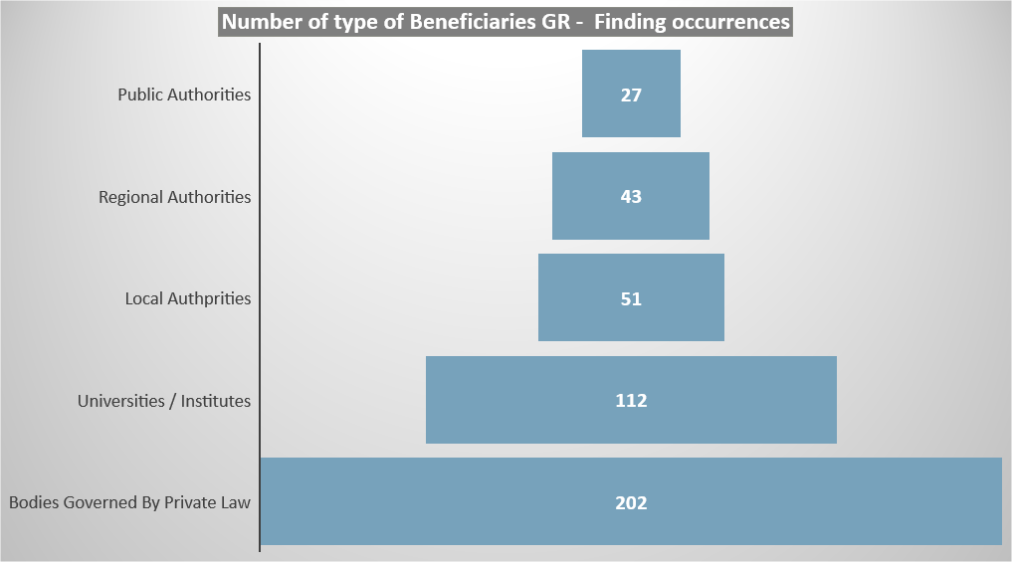
Population of administrative verifications – finding level

Slide 6
Population of administrative verifications – finding level
Finding code | Finding description
1_11 | Use of criteria for exclusion, selection, award or conditions for performance of contracts or technical specifications that are not discriminatory in the sense of 1.10 but still restrict access for economic operators
1_24 | Others
5_1 | Missing or incorrect supporting information or documentation
7_1 | Accounting and calculation errors at project level
8_9_1 | Other ineligible of expenditure (non-compliance with national eligibility rules) related to staff cost
8_9_2 | Other ineligible of expenditure (non-compliance with national eligibility rules) related to travel & accommodation
8_9_8 | Other ineligible of expenditure (non-compliance with national eligibility rules) related to excess budget
8_9_9 | Other ineligible of expenditure (non-compliance with national eligibility rules

Slide 7
Population of administrative verifications – finding level
Finding code | Finding description
1_10 | Use of - criteria for exclusion, selection, award or - conditions for performance of contracts or- technical specifications that are discriminatory on the basis of unjustified national, regional or local preferences
1_11 | Use of criteria for exclusion, selection, award or conditions for performance of contracts or technical specifications that are not discriminatory in the sense of 1.10 but still restrict access for economic operators
1_14 | Selection criteria (or technical specifications) were modified after opening of tenders or were incorrectly applied.
1_15 | Evaluation of tenderers/candidates using unlawful selection or award criteria
1_24 | Others
5_1 | Missing or incorrect supporting information or documentation
7_1 | Accounting and calculation errors at project level
8_9_9 | Other ineligible of expenditure (non-compliance with national eligibility rules
Non eligible amount vs type of finding – all countries

Slide 8
Administrative Findings: GR - all countries
Finding Code | Finding Description - GR
1_11 | Use of criteria for exclusion, selection, award or conditions for performance of contracts or technical specifications that are not discriminatory in the sense of 1.10 but still restrict access for economic operators
1_24 | Others
5_1 | Missing or incorrect supporting information or documentation
5_2 | Lack or incomplete audit trail
7_1 | Accounting and calculation errors at project level
8_9_1 | Other ineligible of expenditure (non-compliance with national eligibility rules) related to staff cost
8_9_2 | Other ineligible of expenditure (non-compliance with national eligibility rules) related to travel & accommodation
8_9_8 | Other ineligible of expenditure (non-compliance with national eligibility rules) related to excess budget
8_9_9 | Other ineligible of expenditure (non-compliance with national eligibility rules
Finding code | Finding description – all countries
1_11 | Use of criteria for exclusion, selection, award or conditions for performance of contracts or technical specifications that are not discriminatory in the sense of 1.10 but still restrict access for economic operators
1_24 | Others
5_1 | Missing or incorrect supporting information or documentation
7_1 | Accounting and calculation errors at project level
8_9_1 | Other ineligible of expenditure (non-compliance with national eligibility rules) related to staff cost
8_9_2 | Other ineligible of expenditure (non-compliance with national eligibility rules) related to travel & accommodation
8_9_8 | Other ineligible of expenditure (non-compliance with national eligibility rules) related to excess budget
8_9_9 | Other ineligible of expenditure (non-compliance with national eligibility rules

Slide 9
Population of on-the-spot verifications – finding level
Finding Code | Finding Description
1_24 | other finding concerning the public contracts
1_3 | Lack of justification for not subdividing a contract into lots
16_1 | Other cases of non-compliance with Beneficiary obligations (eg timetable, file of records etc.
5_1 | Missing or incorrect supporting information or documentation
7_1 | Accounting and calculation errors at project level
8_9 | Other ineligible expenditure

Slide 10
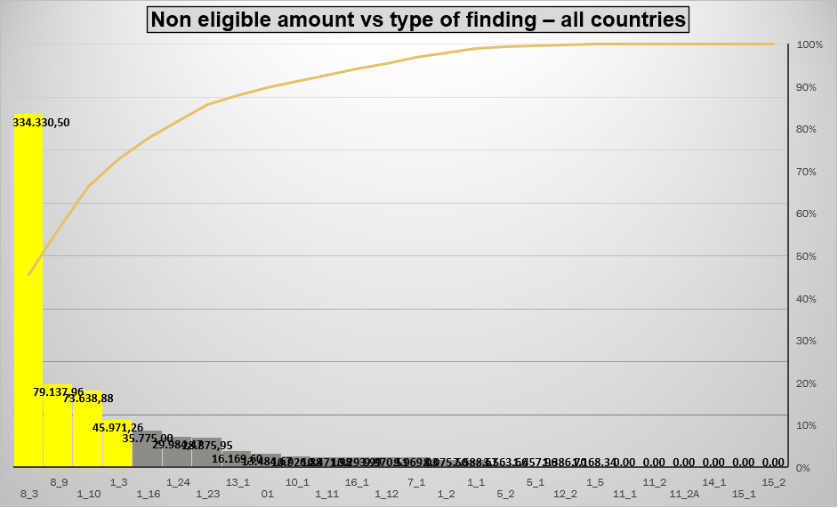
Population of on-the-spot verifications – finding level
Finding Code | Finding Description
1_10 | Use of - criteria for exclusion, selection, award or - conditions for performance of contracts or- technical specifications that are discriminatory on the basis of unjustified national, regional or local preferences
1_3 | Lack of justification for not subdividing a contract into lots
8_3 | Expenditure not related to the project
8_9 | Other ineligible expenditure

Slide 11
Conclusion
MA needs to carry out the risk assessment ex-ante, before they start to carry out management verification. The risk assessment is carried out globally, for the totality of operations, payment claims and beneficiaries, but by taking in due account the risk elements.
The risk assessment could be carried out at the very beginning of the programme (by considering the experience in 2014-2020). Additionally, the MA could decide to wait for the selection of operations, as at that time they collect important information about the risks related to the operations and beneficiaries which can be used in the risk assessment for management verifications (the type and complexity of operations/beneficiaries/categories of expenditure expected).
Taking into account the statistical data analysis, as presented above, and the experience gained during the previous years, the MA can build on this pre-existing work. Thus, the following key elements/factors (among others) could be considered as “critical” for the “risk-based” methodology:
Type of beneficiary (e.g., Bodies governed by Private Law, Universities/Institutions, Municipalities, etc.)
Public procurement procedures
Cost category (e.g. staff is the most “problematic” cost category due to variety of options to calculate these costs, different national procedures, etc.)

Slide 12
Management verifications in Interreg
INTERACT Workshop
Risk based management verifications
2021 - 2027 Programming Period

Slide 13
Risk based management verifications methodology.
main issues/questions
To avoid any risk, some Programmes will need to go for the 100% verification
Will management verifications continue to be organized on MS level?
There will be two separate risk analysis for administrative and on – the - spot verifications
Is it encouraged for MA to cooperate with AA and FLC in developing risk-management strategy?

Slide 14
Risk based management verifications methodology.
main issues/questions
A “risk-list” of beneficiaries regarding their past performance could be probably a “good start” for management verifications
Does AA check the same sample as MA?
How the SCOs will be audited in the sample-based methodology?

Slide 15
Risk based management verifications methodology.
main issues/questions
How to deal with Public Procurements, taking into account that different MS have different national thresholds and the sampling methodology (based on specific amounts above which the sample will be applied) may create problems
The sampling methodology is an advantage mainly for centralized FLC systems. For decentralized systems, it is very difficult for the controllers (physical persons) to have the knowledge needed for the inherent risk assessment (e.g. beneficiary’s experience, capacity, implemented projects, etc.)

Slide 16
Risk based management verifications methodology.
Approach and general principles
The management verifications planning is based on a risk assessment carried out at partner level, taking into account specific risk factors
The methodology will be “identical” for administrative and on-the-spot verifications
The MA will consider some risk factors at the stage of selection of operations (recorded in project evaluation forms). This work will be taken into account when the risk assessment for management verifications is performed.
The risk factors are related to information about the beneficiary (e.g. experience) and the project (type/nature, complexity, amendments, financial corrections, etc.). More details in next presentation.

Slide 17
Risk based management verification methodology.
Approach and general principles
Not all payment claims from beneficiaries and not all operations have to be subject to a management verification
Within a payment claim or operation, not all items will be verified
Risk factors receive values and scores, automatically, through data entry into the Management Information System (MIS).
The initial risk assessment, with the automatic assignment of an overall grade to each project/partner, will be done immediately after its entry to the MIS (first picture of its "dangerousness“). This grade varies during its implementation, as the data feeding the values of the individual risk factors changes, and is automatically updated when the methodology is applied

Slide 18
Risk based management verification methodology.
Approach and general principles
In administrative verifications, sampling rules and criteria are defined at two levels: a) Payment Claim level and b) expenditure level, when more than one expenditure category participates in the declaration.
In “on-the-spot” verifications, sampling will be applied to a given population of partners/expenditures which is selected to be verified on-the-spot.
The methodology allows the use of the FLC “professional judgment” in order to increase the sample (categories, correlations, etc.).
The approach will be subject to revision

Slide 19
Risk based management verification methodology.
Administrative verifications
As basic rule, the first payment claim (PC) submitted by the beneficiary, should be verified.
Each PC which includes a first expenditure based on simplified cost options, should be verified
First PC containing expenditure for procurement contracts or staff should be verified
The above “rules” need to be justified through historical data analysis

Slide 20
Risk based management verification methodology.
Administrative verifications
If the FLC detects irregular expenditure, may expand the sample to other PCs or correlations within the PC (relevant box in the MIS),, depending on the nature and extent of the irregularities, in order to establish whether the same type of findings appear in the unaudited population of expenses. In this context, the FLC may decide to extend the sample only to the category or categories of expenditure to which the detected irregularities related, or to more categories or even to the total VC.

Slide 21
Risk based management verification methodology.
On-the-spot verifications
The steps of the “on-the-spot” sampling methodology, will include (indicatively):
Population definition (each semester)
For the first period, the number of all the operations whose expenditure was administratively verified during the second semester of the accounting year (01/07/ v-1 to 31/12/v-1) is defined
For the second period, the number of all operations whose expenditure was administratively verified in the first semester of the accounting year (01/01/v to 30/06/ν), deducting the Operations whose expenditure was verified on-the-spot during the first audit period of the same accounting year
Sample selection (risk assessment – identical to administrative), based on predetermined criteria (e.g. high % of implementation, identified management problems or irregularities, etc.)
Determination of sample size (e.g. 15% of operations and 20% of expenses)
Preparation of the “on-the-spot” verifications program

Slide 22
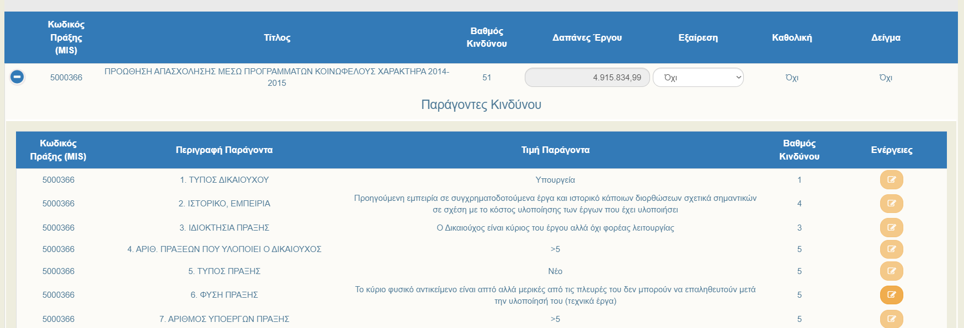
Management Information System - MIS
MIS Code
Risk score
Title
Expenses
Risk Factors
MIS
Risk criteria
Description
Risk score
Actions
Type of beneficiary
Experience / historical data
Project’s owner
Number of projects implemented
Type of project
Nature of project
Number of partners
Ministry
Former experience and historical data of financial corrections
Yes
>5
New
Soft project
>5

Slide 23
Thank you for your attention
UNIT C’ “MANAGEMENT VERIFICATION UNIT”
MANAGING AUTHORITY “INTERREG 2021-2027”

